Slide 1

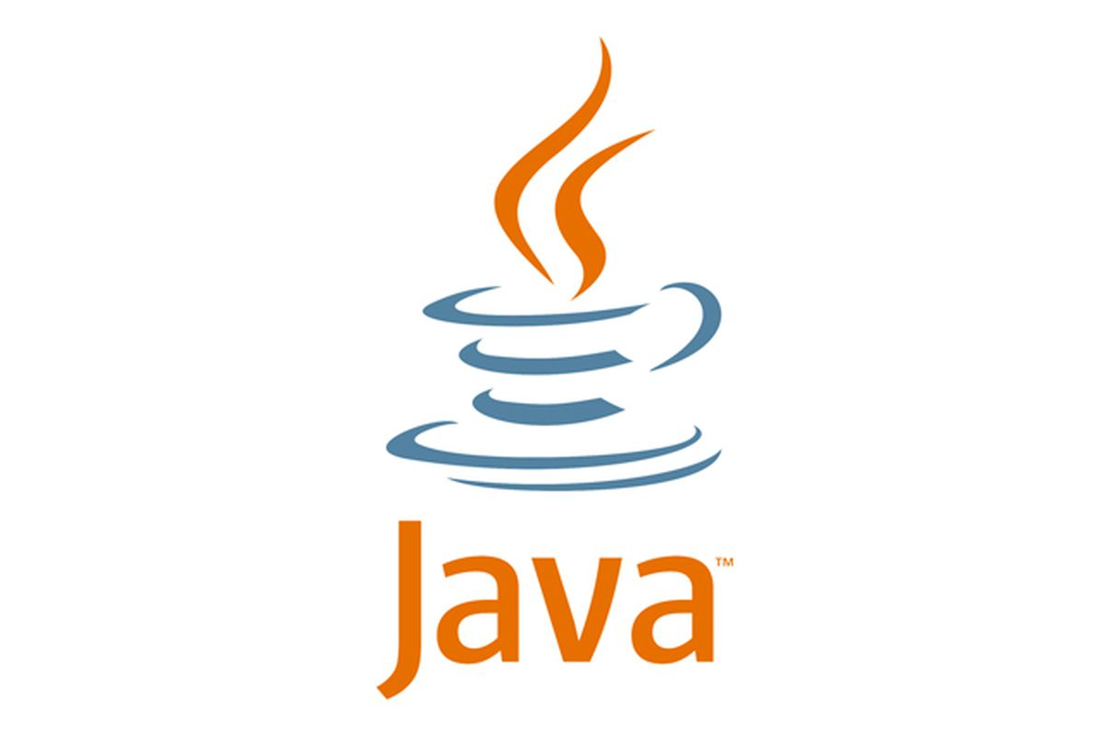

Java Programming Fundamentals

Slide 2

Agenda
Java Language
Key Attributes of Object-Oriented Programming
Java Development Kit

Slide 3
Introduction
Originally developed by SUN Microsystems which was initiated by James Gosling and released in 1995.
JAVA is platform independent language
The History of Java
The green project began in 1991
Original language name: OAK
Name changed to JAVA
First public release in 1995
Write once , Run every where

Slide 4
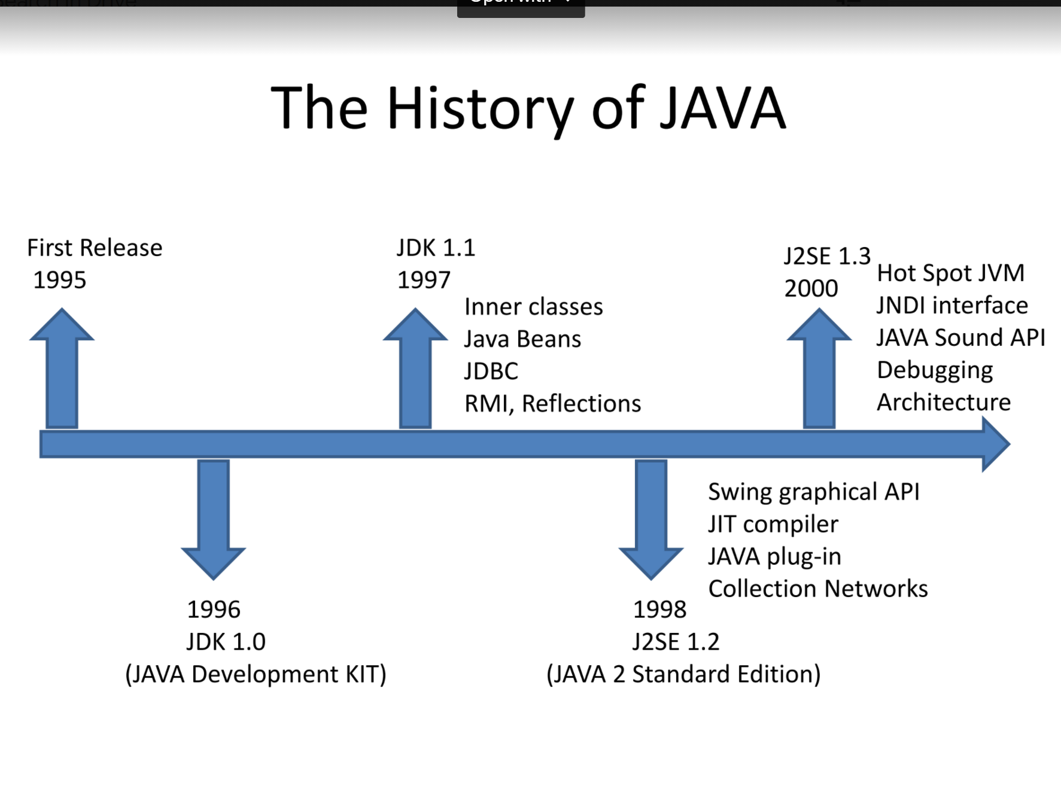

Slide 5
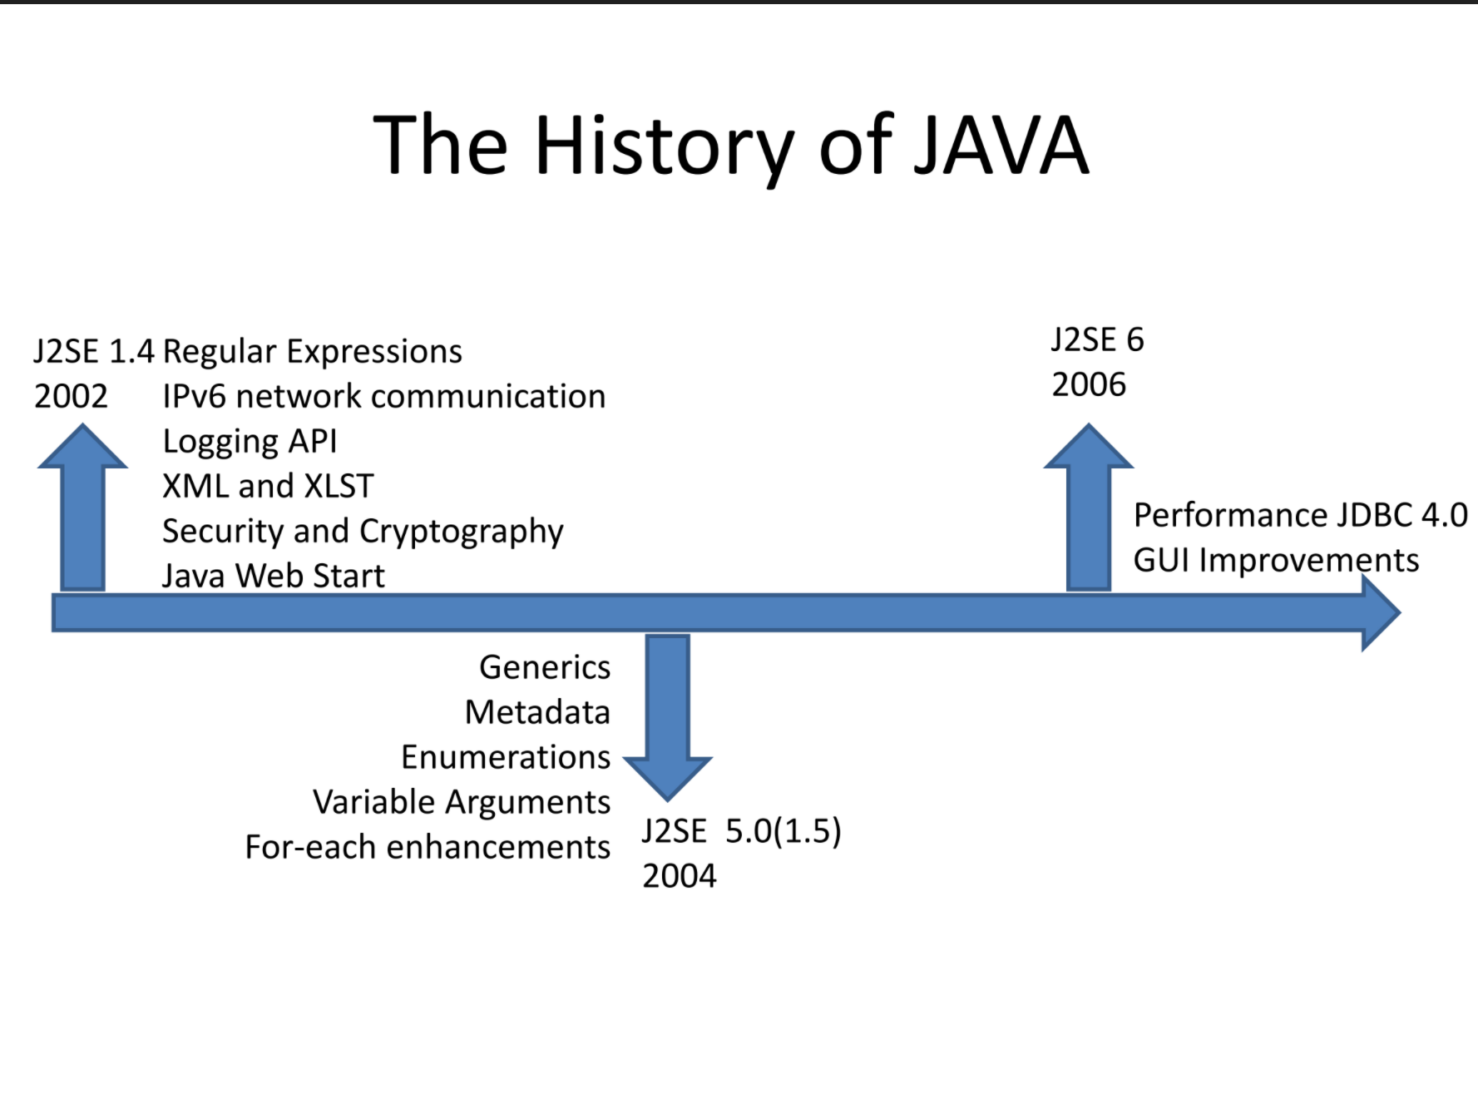

Slide 6
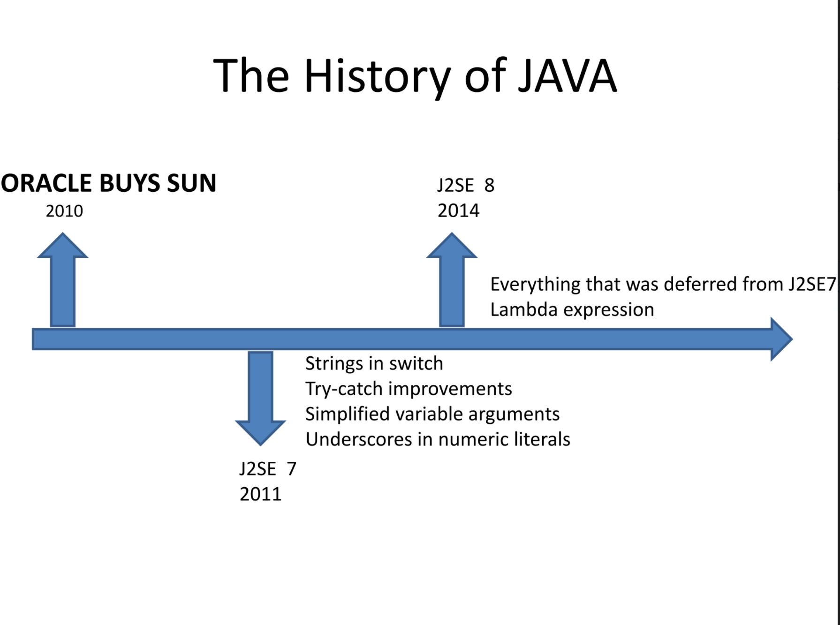
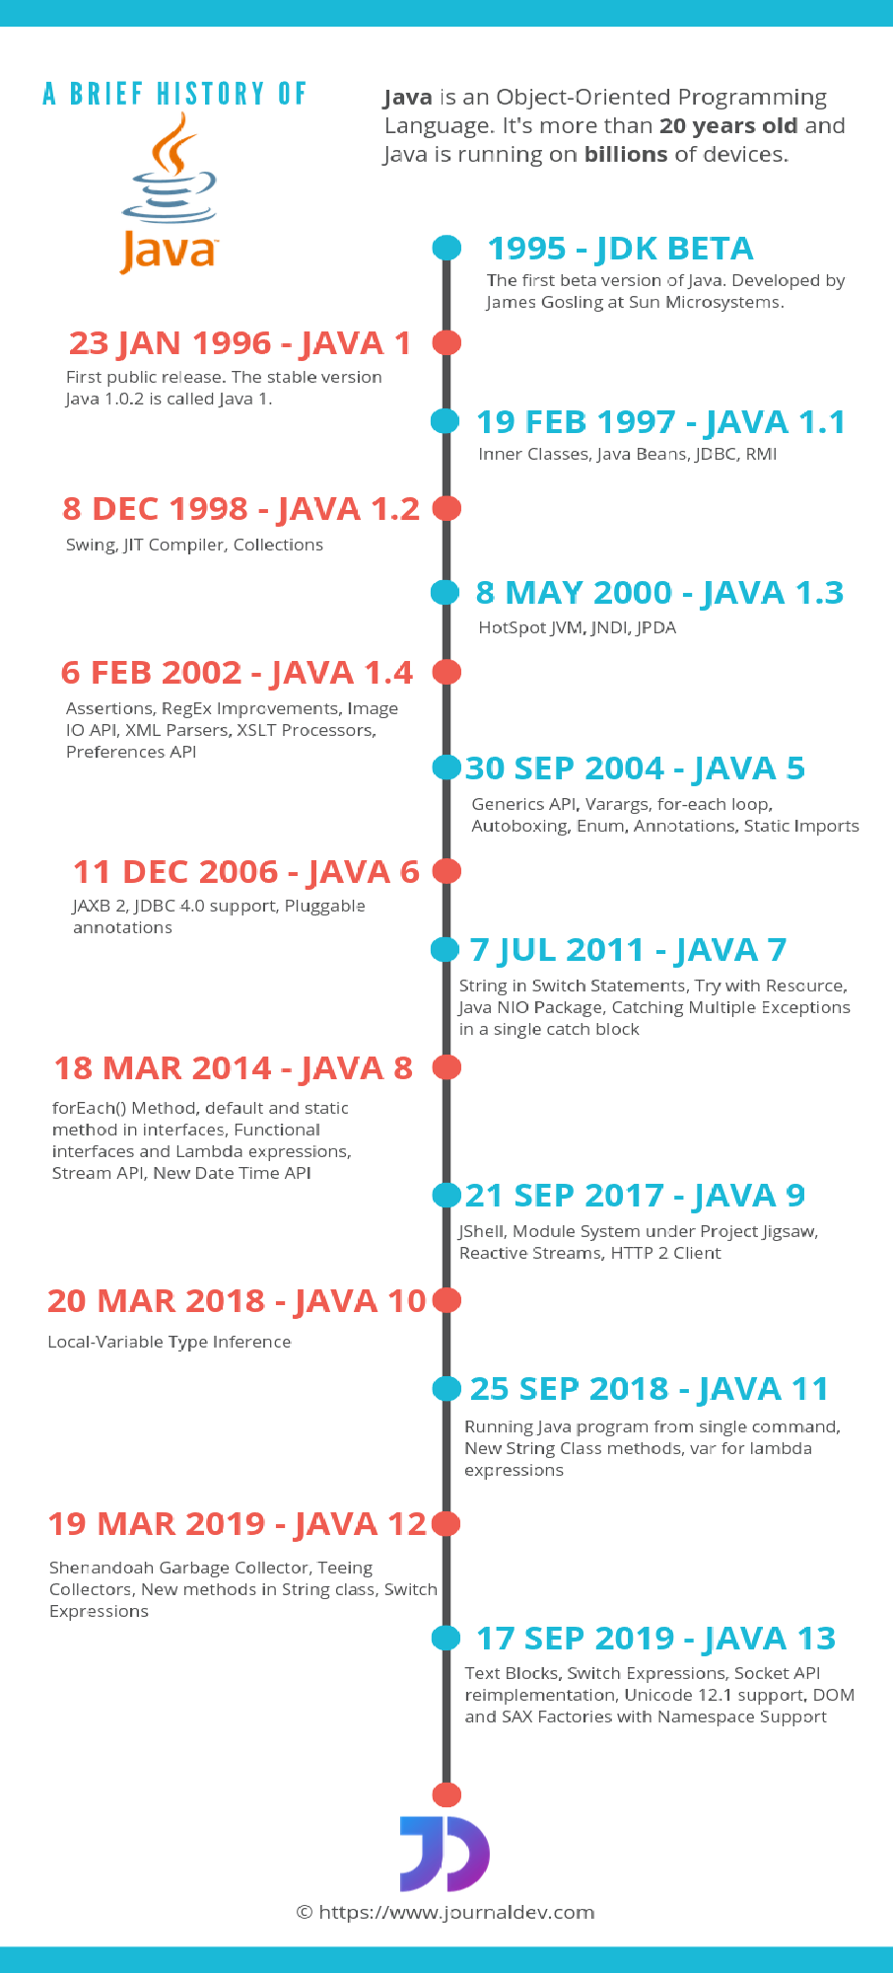

Slide 7

Java IDE Tools
Net Beans.
Eclipse.
My eclipse
Edit Pulse.
IntelliJ IDEA Community Edition.
Android Studio.
Enide Studio 2014.
BlueJ.
jEdit.
jGRASP.
Oracle JDevelopers.

Slide 8
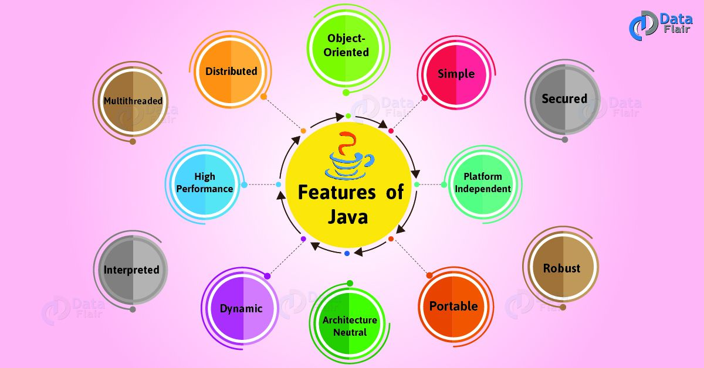
The Java Buzzwords (Features Of Java)
Simple
Object-Oriented
Portable
Platform independent
Secured
Robust
Architecture neutral
Interpreted
High Performance
Multithreaded
Distributed
Dynamic

Slide 9
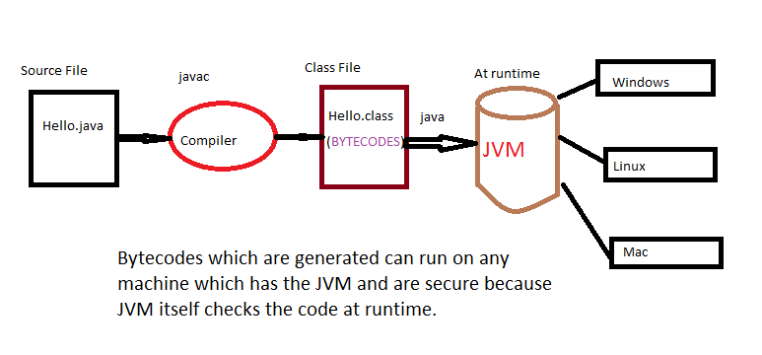
JVM is an interpreter for bytecode

Slide 10
Java Editions
Java Java Standard Edition(JavaSE):- can be used to develop client side standalone applications or applets.
Java Enterprise Edition(JavaEE) :- can be used to develop server side applications such as java servlets and java server pages .
Java Micro Edition(JavaME):- can be used to develop applications for mobile devices such as cell phone

Slide 11
Object-Oriented Programming
Object-oriented programming is at the core of Java
All computer programs consist of two elements: code and data
A program can be conceptually organized around its code or around its data
That is, some programs are written around “what is happening” and others are written around “who is being affected.”
The first way is called the process-oriented model
The process-oriented model can be thought of as code acting on data
The second approach, Object-oriented programming organizes a program around its data (that is, objects) and a set of well-defined interfaces to that data

Slide 12
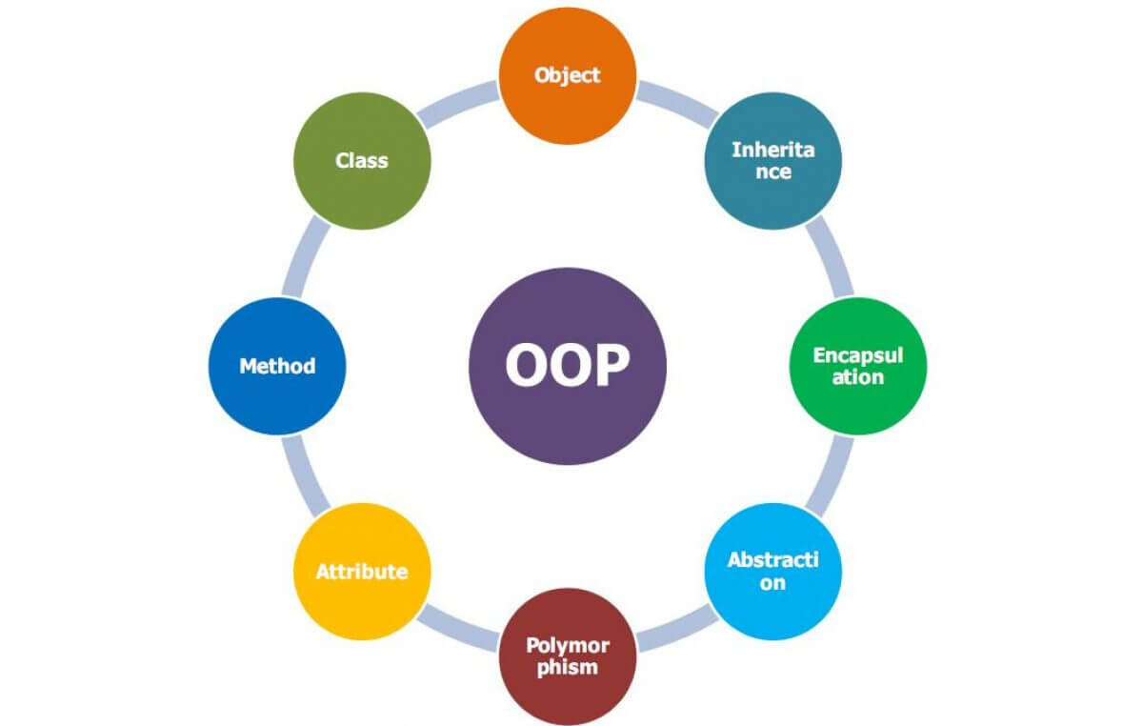
Key Features of Object-Oriented Programming
Object-Oriented Programming is a methodology or paradigm to design a program using classes and objects. It simplifies software development and maintenance by providing some concepts:
Object
Class
Inheritance
Polymorphism
Abstraction
Encapsulation

Slide 13
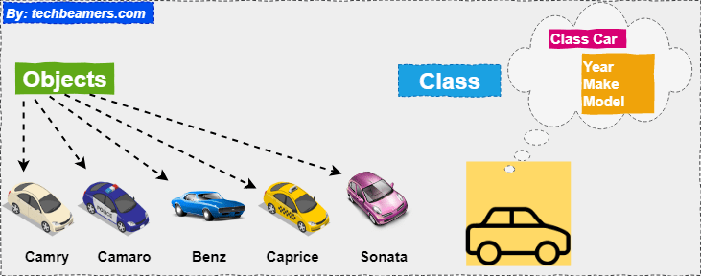
Object:
An Object can be defined as an instance of a class. An object contains an address and takes up some space in memory.
Objects can communicate without knowing the details of each other's data or code.
Example: A dog is an object because it has states like color, name, breed, etc. as well as behaviors like wagging the tail, barking, eating, etc.
Class:
Collection of objects is called class. It is a logical entity.
A class can also be defined as a blueprint from which you can create an individual object. Class doesn't consume any space.

Slide 14
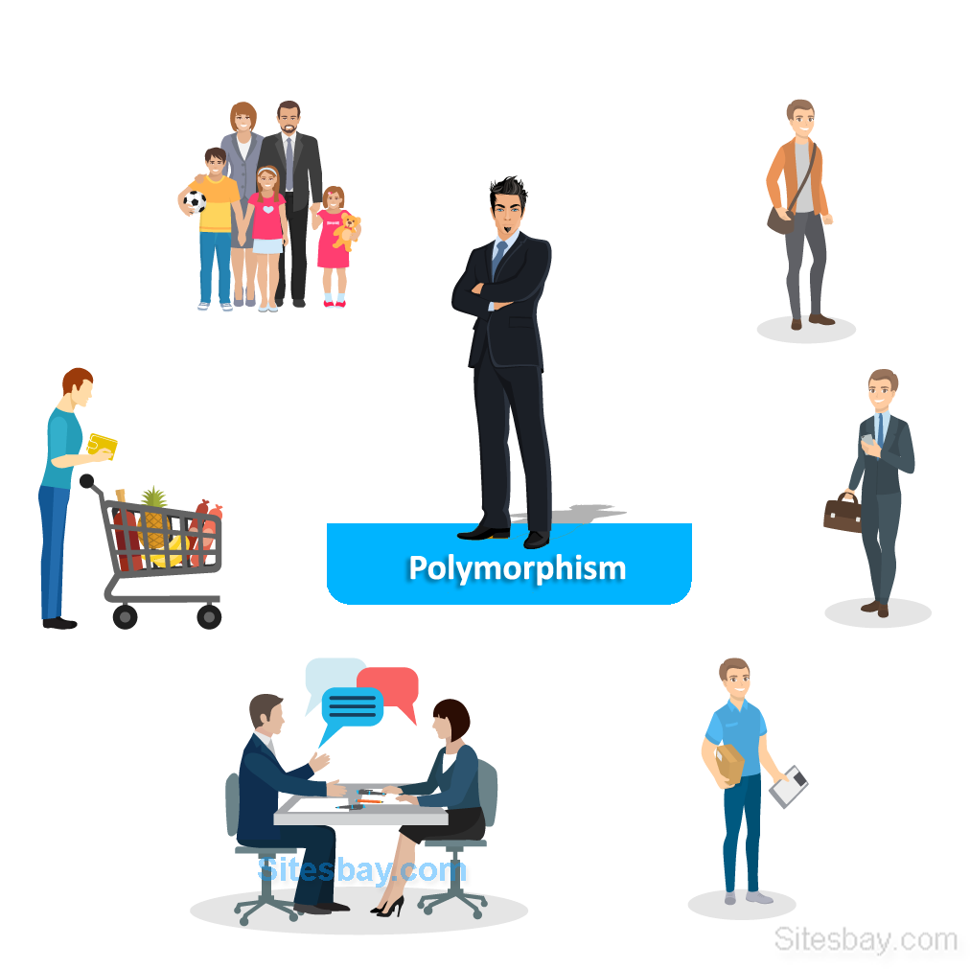
Inheritance:
When one object acquires all the properties and behaviors of a parent object, it is known as inheritance. It provides code reusability. It is used to achieve runtime polymorphism.
Polymorphism
If one task is performed in different ways, it is known as polymorphism.
For example: to convince the customer differently, to draw something, for example, shape, triangle, rectangle, etc.
In Java, we use method overloading and method overriding to achieve polymorphism.

Slide 15
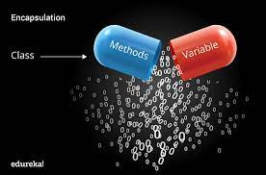
Abstraction
Hiding internal details and showing functionality is known as abstraction.
For example phone call, we don't know the internal processing.
In Java, we use abstract class and interface to achieve abstraction.
Encapsulation
Binding (or wrapping) code and data together into a single unit are known as encapsulation.
For example, a capsule, it is wrapped with different medicines.
A java class is the example of encapsulation. Java bean is the fully encapsulated class because all the data members are private here.

Slide 16
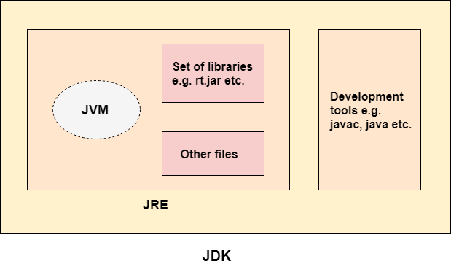
Java Development Kit
The Java Development Kit (JDK) is a software development environment used for developing Java applications and applets.
It includes
Java Runtime Environment (JRE),
an interpreter/loader (java),
a compiler (javac),
an archive (jar),
a documentation generator (javadoc) and
other tools needed in Java development.

Slide 17
Development Tools (In the bin/ subdirectory) Tools and utilities that will help you develop, execute, debug, and document programs written in the JavaTM programming language.
Runtime Environment (In the jre/ subdirectory) An implementation of the Java Runtime Environment (JRE) for use by the JDK. The JRE includes a Java Virtual Machine (JVM), class libraries, and other files that support the execution of programs written in the Java programming language.
Additional Libraries (In the lib/ subdirectory) Additional class libraries and support files required by the development tools.
Demo Applets and Applications (In the demo/ subdirectory) Examples, with source code, of programming for the Javaplatform. These include examples that use Swing and other Java Foundation Classes, and the Java Platform Debugger Architecture.
Sample Code (In the sample subdirectory) Samples, with source code, of programming for certain Java API’s.
C header Files (In the include/ subdirectory) Header files that support native-code programming using the Java Native Interface, the JVM Tool Interface, and other functionality of the Java platform.

Slide 18
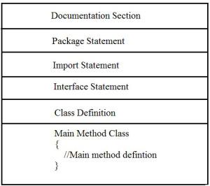
Structure of Java programming

Slide 19
Documentation section | It comprises of a comment line which gives the program name, the programmer’s name and some other details. In addition to the 2 styles of comments i.e., /*....*/ and //, Java also provides another style of comment i.e. /**….*/.
Package statement | The first statement allowed in Java file is the Package statement which is used to declare a package name and it informs the compiler that the classes defined within the program belong to this package. It is declared as: package package_name;
Import statements | It includes statements used for referring classes and interfaces that are declared in other packages. It is similar to the #include statement in C and C++. Example:import java.util.Scanner; (we can use members of Scanner class.) import java.util.*; (This includes all the classes and interfaces of util package).
Interface statements | Interfaces are like a class that includes a group of method declarations. This is an optional section and can be used only when programmers want to implement multiple inheritances within a program.
Class definition | A Java program may contain multiple class definitions. Classes are the main and important elements of any Java program. These classes are used to plot the objects of the real world problem.
Main Method class | Since every Java stand-alone program requires the main method as the starting point of the program. This class is essentially a part of Java program. A simple Java program contains only this part of the program.

Slide 20
Sample Java Program
//Simple java program -- Documentation section class Demo { public static void main(String[] args) { System.out.println("Welcome to java world"); } }

Slide 21


